Slide 1
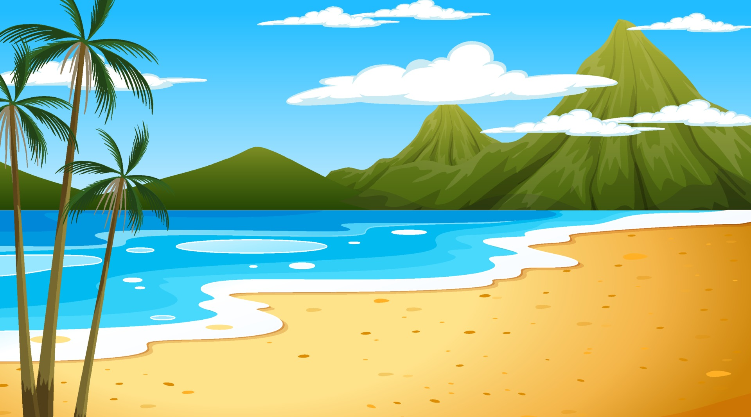
Escape room
Slovenia

Slide 2
Press any key

Slide 3
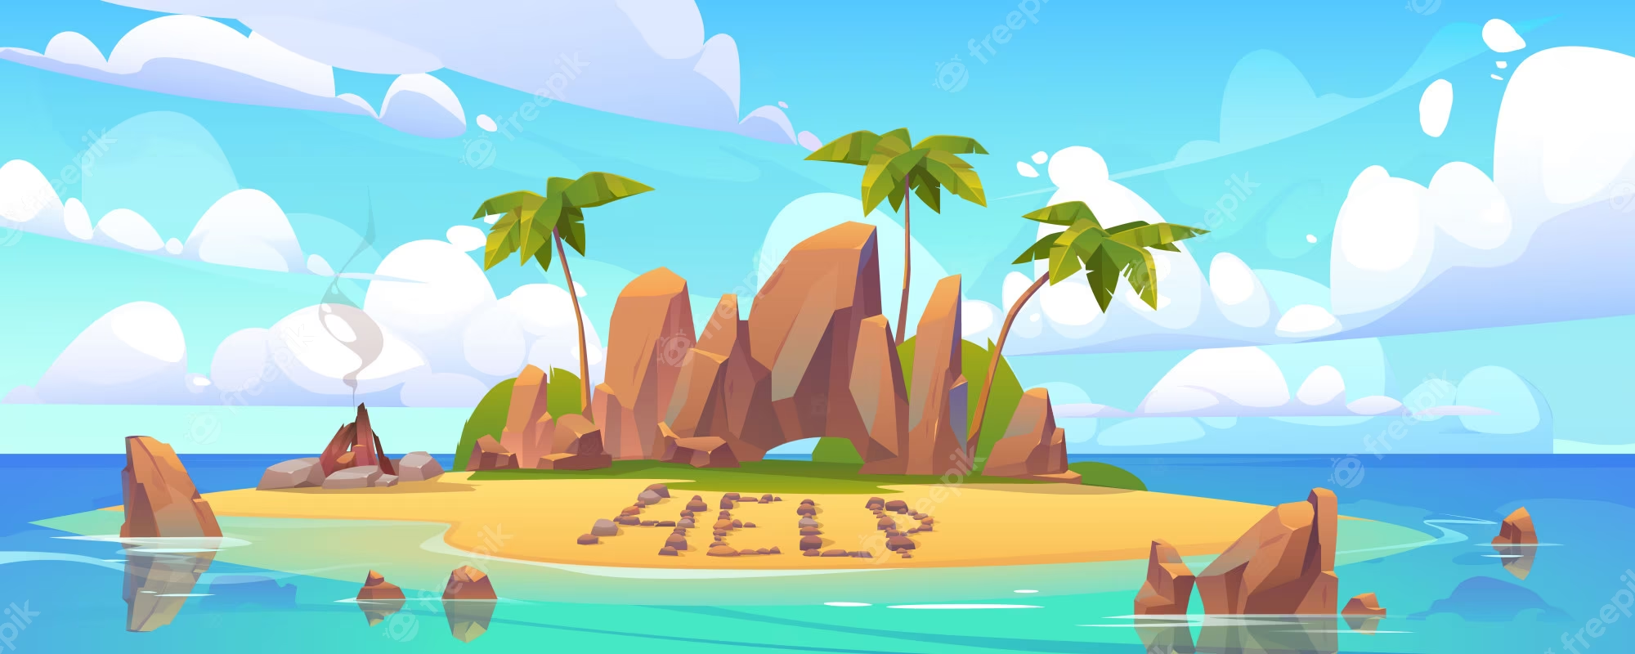
HA-HA! I’ve caught you now!!!
Now you are trapped on a deserted island! If you want to escape, you have to solve my puzzles and escape!
Click on individual objects on the beach to get tasks.
Instructions:
Do not press the spacebar, arrows or keyboard at any time!
Press to start

Slide 4
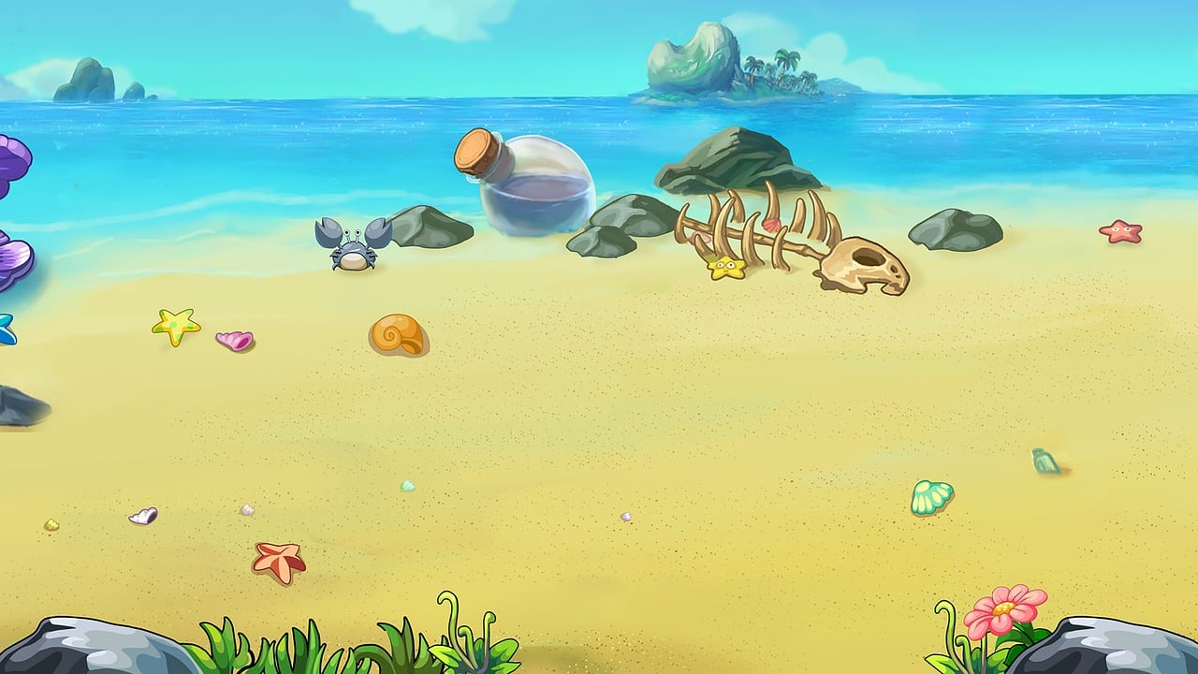

Slide 5
On Monday, the thermometer showed 25°C, on Tuesday 26°C and on Wednesday 27°C. What was the average air temperature?
25°C
26°C
27°C

Slide 6
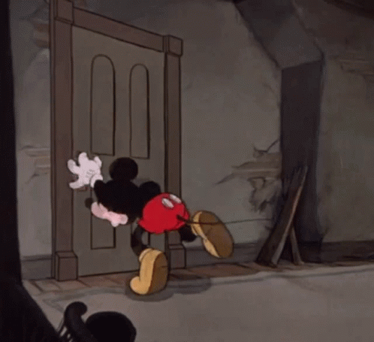
You are still trapped!
Try again

Slide 7
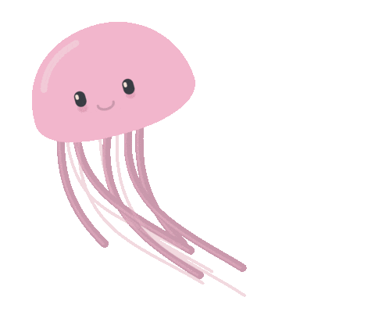
Correct! One step closer to freedom!
Solve another puzzle

Slide 8
During the summer vacation, Ana read 5 books, Miha read 7 books and Matic 3 books. How many books did they read on average?
3
5
7

Slide 9
You are still trapped!
Try again

Slide 10
Correct! One step closer to freedom!
Solve another puzzle

Slide 11
Jan was on vacation for 12 days, Peter for 8 days, Maja for 7 days and Matic for 13 days. How many days on average were they at sea?
9
12
10

Slide 12
You are still trapped!
Try again

Slide 13
Correct! One step closer to freedom!
Solve another puzzle

Slide 14
Have you solved all three tasks yet?
YES
NO

Slide 15
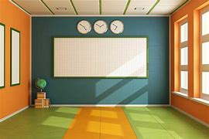
What three animals were shown in the GIFs by the correct puzzle answers?
A fish, a jellyfish and a turtle.
A fish, a whale and a jellyfish.
A jellyfish, a dolphin and a fish.
A turtle, a jellyfish and a seahorse.

Slide 16
Well done, you escaped from the lonely island!
Escape!

Slide 17
